Slide 1
Citizenship Class
Session 1: Introductions, Maps, Symbols, and Holidays

Slide 2
Class Overview
Class goals
Practice English
Understand and answer the 100 questions
Prepare to complete and submit the citizenship application
How the class goes
Worksheets, Presentations, and Homework

Slide 3
Session 1: Introductions, Maps, Symbols, and Holidays

Slide 4
Introductions
My name is: first name, last name
My name is: Maggie Peterson
I am from: country
I am from: the United States
I live in: the city you live in
I live in: Wapello

Slide 5
MAPS

Slide 6
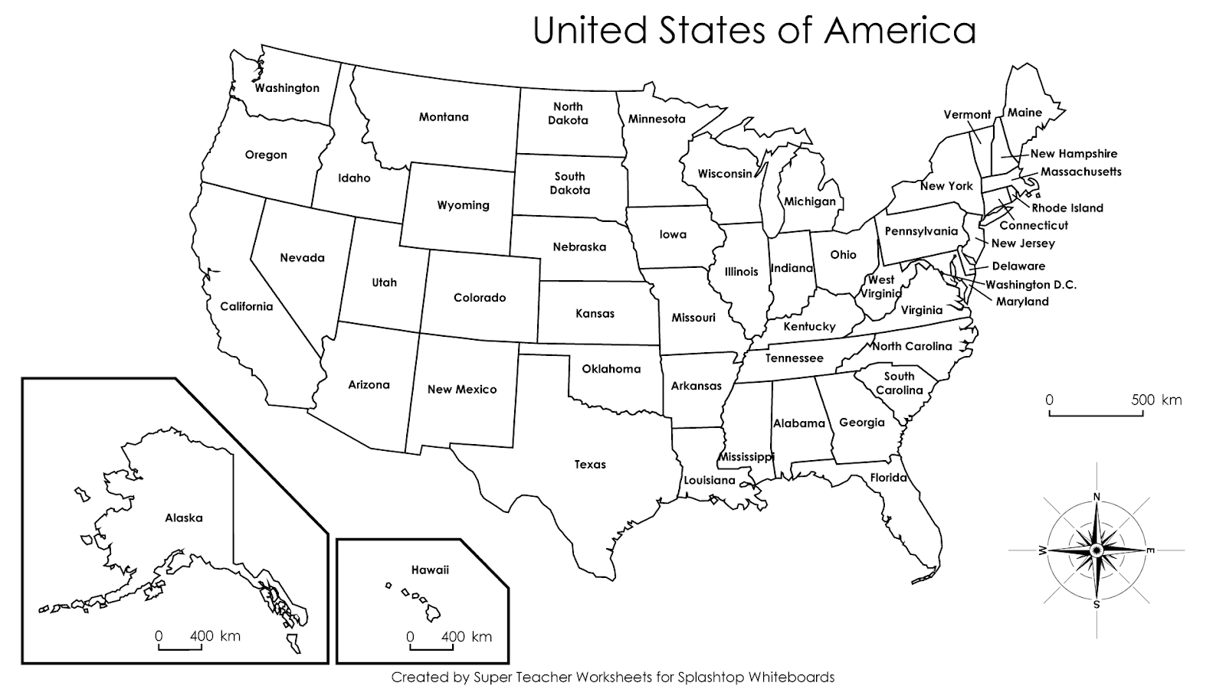

Slide 7
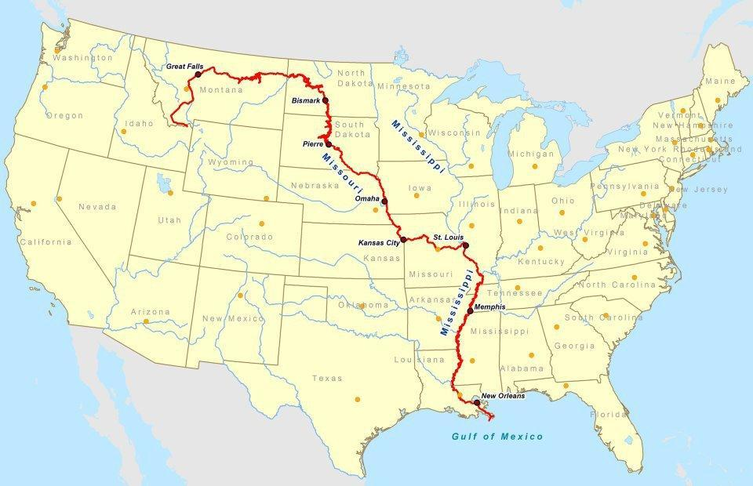
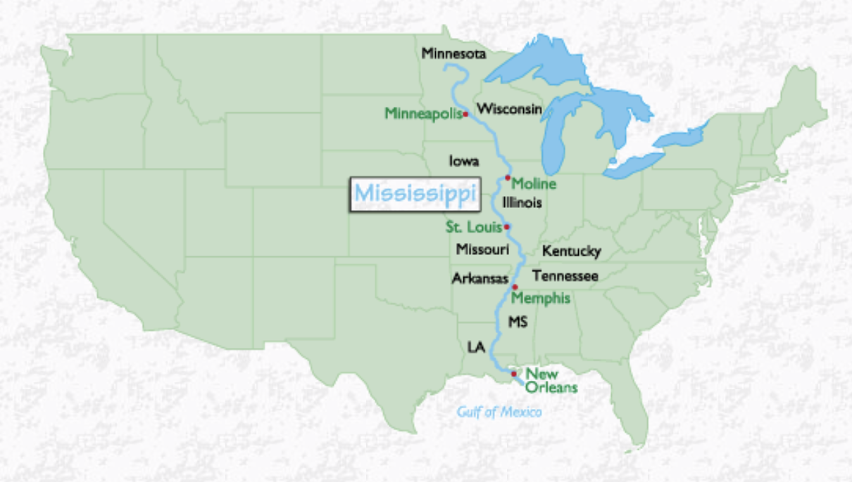
Two of the longest rivers in the United States are the Missouri River and the Mississippi River.
Missouri River
Mississippi River

Slide 8
Two of the longest rivers in the United States are the Missouri River and the Mississippi River.
Question #1:
Missouri River
Mississippi River

Slide 9
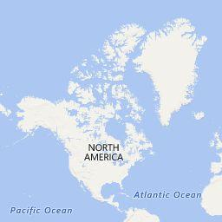
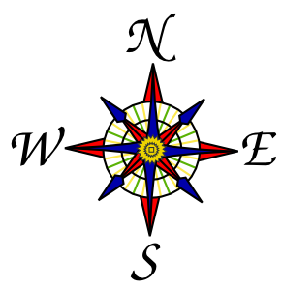
The Pacific Ocean is on the west coast of the United States. The Atlantic Ocean is on the east coast.
Pacific Ocean
Atlantic Ocean

Slide 10
The Pacific Ocean is on the west coast of the United States. The Atlantic Ocean is on the east coast.
Question #2 and #3:
Pacific Ocean
Atlantic Ocean

Slide 11
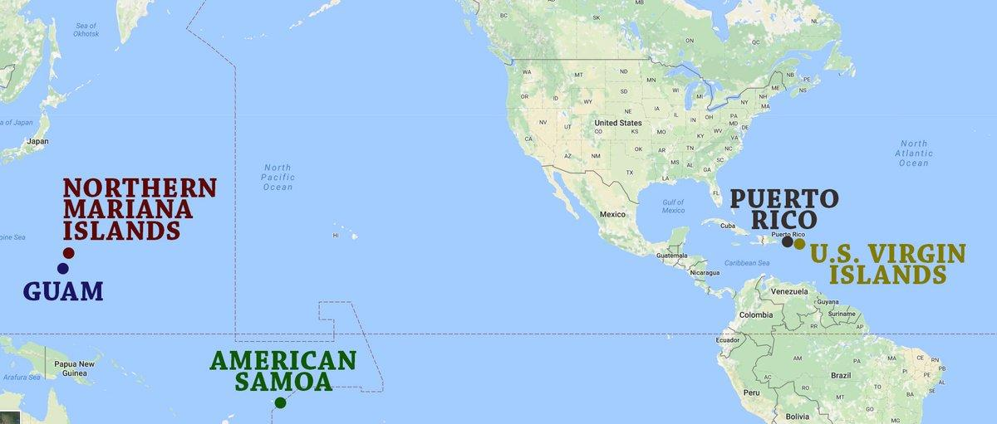
The United States has states and territories. The territories are shown on the map. Guam is a US Territory.
Notes:
Guam is the shortest, and easiest to say/spell. There are four others shown on this picture: Northern Mariana Islands, American Samoa, Puerto Rico, and U.S. Virgin Islands. Any of these five are correct answers. You should pick the one that is the easiest for you to remember/say/spell.

Slide 12
The United States has states and territories. The territories are shown on the map. Guam is a US Territory.
Question #4:
Notes:
Guam is the shortest, and easiest to say/spell. There are four others shown on this picture: Northern Mariana Islands, American Samoa, Puerto Rico, and U.S. Virgin Islands. Any of these five are correct answers. You should pick the one that is the easiest for you to remember/say/spell.

Slide 13
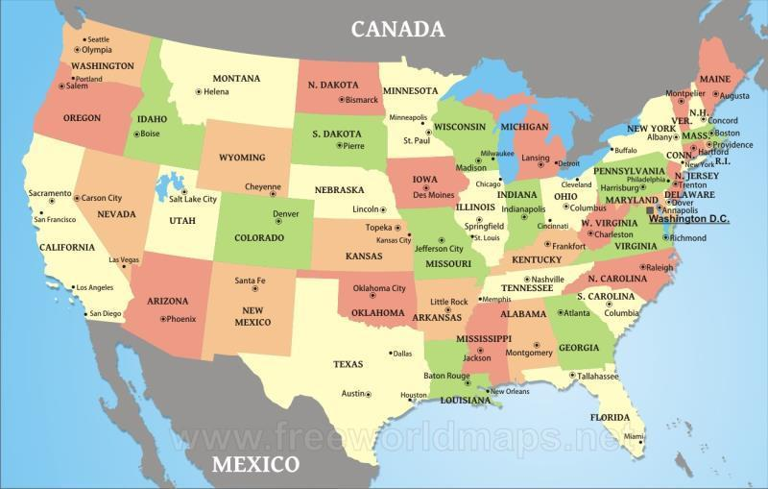
Canada is to the north of the United States. Washington is one state that borders Canada.

Slide 14
Canada is to the north of the United States. Washington is one state that borders Canada.
Question #5:

Slide 15
Mexico is to the south of the United States. Texas is one state that borders Mexico.

Slide 16
Mexico is to the south of the United States. Texas is one state that borders Canada.
Question #6:

Slide 17
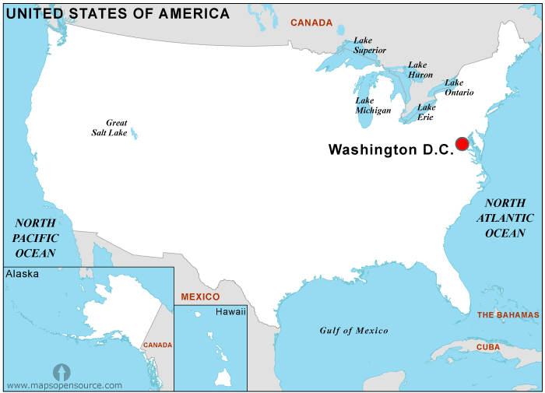
The capital of the United States is Washington D.C. The White House is located there.

Slide 18
The capital of the United States is Washington D.C. The White House is located there.
Question #7:

Slide 19
SYMBOLS

Slide 20
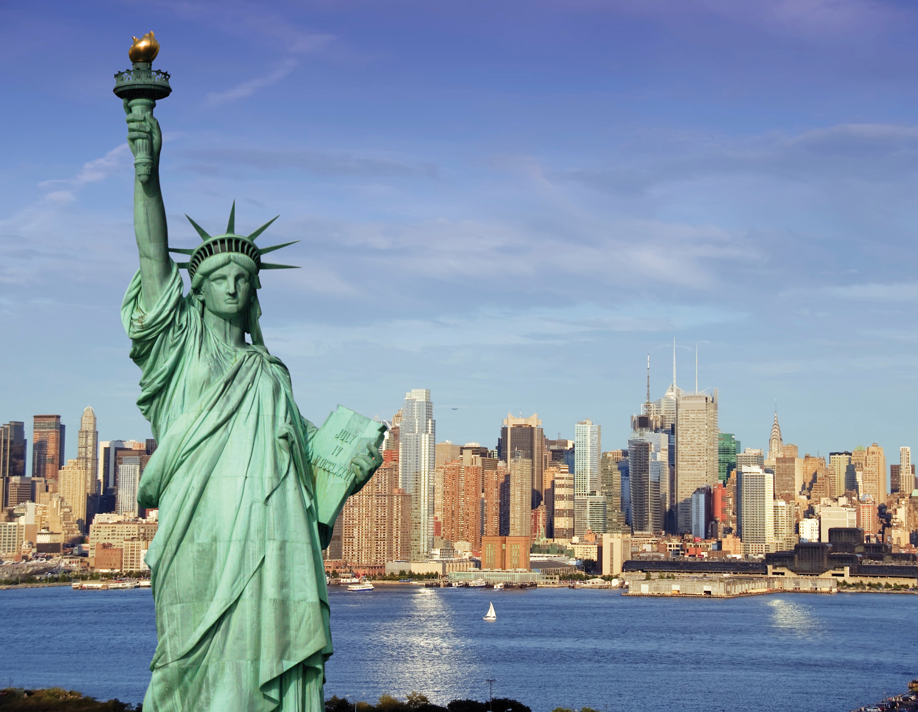
National Symbols - The Statue of Liberty
The Statue of Liberty was a gift of friendship from the people of France to the United States, and is recognized as a universal symbol of freedom and democracy. It is located on Liberty Island, New York.

Slide 21
National Symbols - The Statue of Liberty
Question #8:
The Statue of Liberty was a gift of friendship from the people of France to the United States, and is recognized as a universal symbol of freedom and democracy. It is located on Liberty Island, New York.

Slide 22
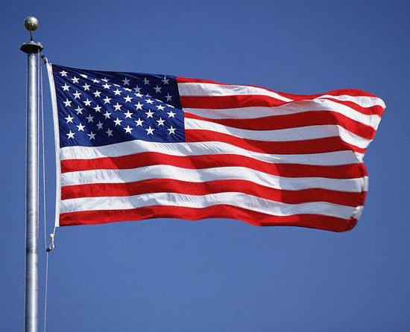
National Symbols - The American Flag
The United States Flag consists of thirteen red and white horizontal stripes, and a blue rectangle in the top left with fifty white stars. The 13 stripes represent the 13 original colonies that declared independence from Great Britain and later became the first states. The 50 stars on the flag represent the 50 states.

Slide 23
National Symbols - The American Flag
Question #9 and #10:
The United States Flag consists of thirteen red and white horizontal stripes, and a blue rectangle in the top left with fifty white stars. The 13 stripes represent the 13 original colonies that declared independence from Great Britain and later became the first states. The 50 stars on the flag represent the 50 states.

Slide 24
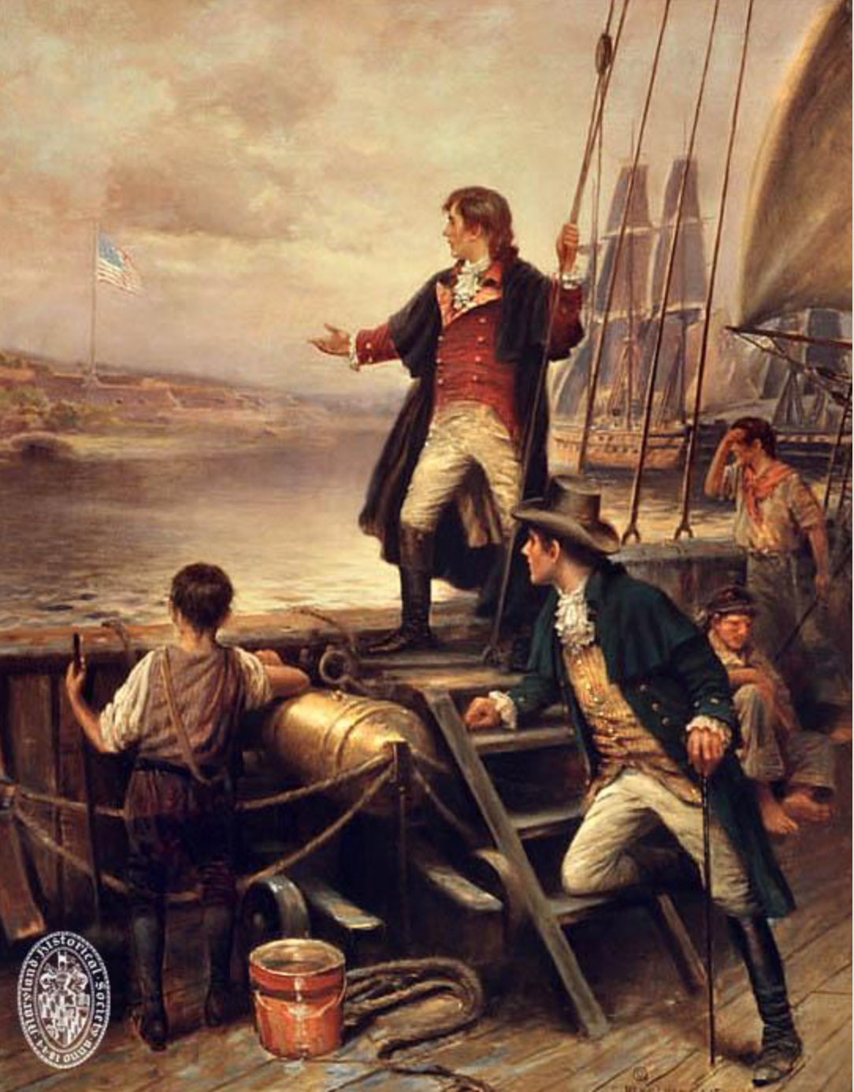
National Symbols - The Star-Spangled Banner
Francis Scott Key wrote the words to “The Star-Spangled Banner” after a battle in the War of 1812. As the British attacked, Francis Scott Key saw that the American flag was still flying over the fort, which showed that the Americans were not defeated. The song became the U.S. National Anthem in 1931. The flag that Key saw is now at a museum in Washington, D.C.

Slide 25
National Symbols - The Star-Spangled Banner
Question #11:
Francis Scott Key wrote the words to “The Star-Spangled Banner” after a battle in the War of 1812. As the British attacked, Francis Scott Key saw that the American flag was still flying over the fort, which showed that the Americans were not defeated. The song became the U.S. National Anthem in 1931. The flag that Key saw is now at a museum in Washington, D.C.

Slide 26
HOLIDAYS

Slide 27
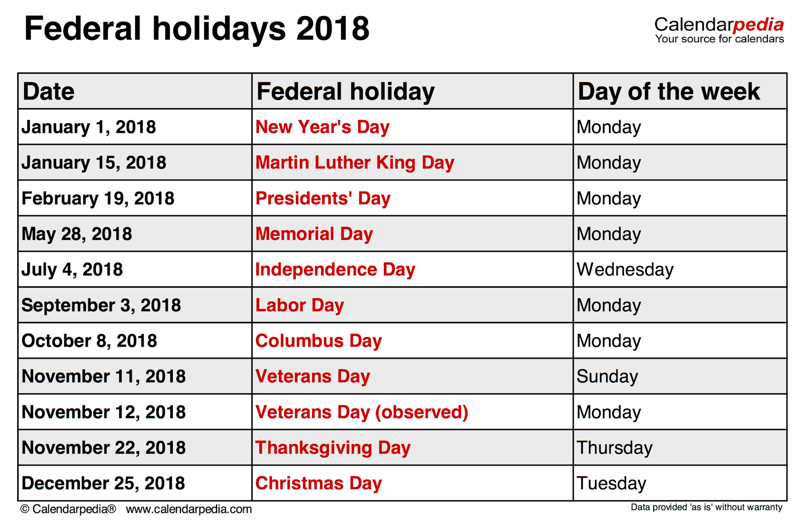
National Holidays
The Declaration of Independence was adopted on July 4, 1776. The anniversary of that date is celebrated as Independence Day. Other national holidays are listed in the table to the right. On these days, government offices are closed.

Slide 28
National Holidays
Question #12 and #13:
The Declaration of Independence was adopted on July 4, 1776. The anniversary of that date is celebrated as Independence Day. Other national holidays are listed in the table to the right. On these days, government offices are closed.
Notes:
For question #13, any of the holidays from this table are correct answers. You just need 2. Two of the most familiar holidays are Thanksgiving and Christmas, as most people do not have to work on these holidays. Pick the two holidays that are the easiest for you to remember/say/spell.

Slide 29
WORKSHEET REVIEW
Missouri River/Mississippi River
Pacific Ocean
Atlantic Ocean
Guam
Washington
Texas
Washington, D.C.
New York
13 original colonies
50 states
The Star-Spangled Banner
July 4
Thanksgiving, Christmas

Slide 30
Dictation Practice
The flag is red, white, and blue.
Canada is north of the United States.
Thanksgiving is in November.

Slide 31
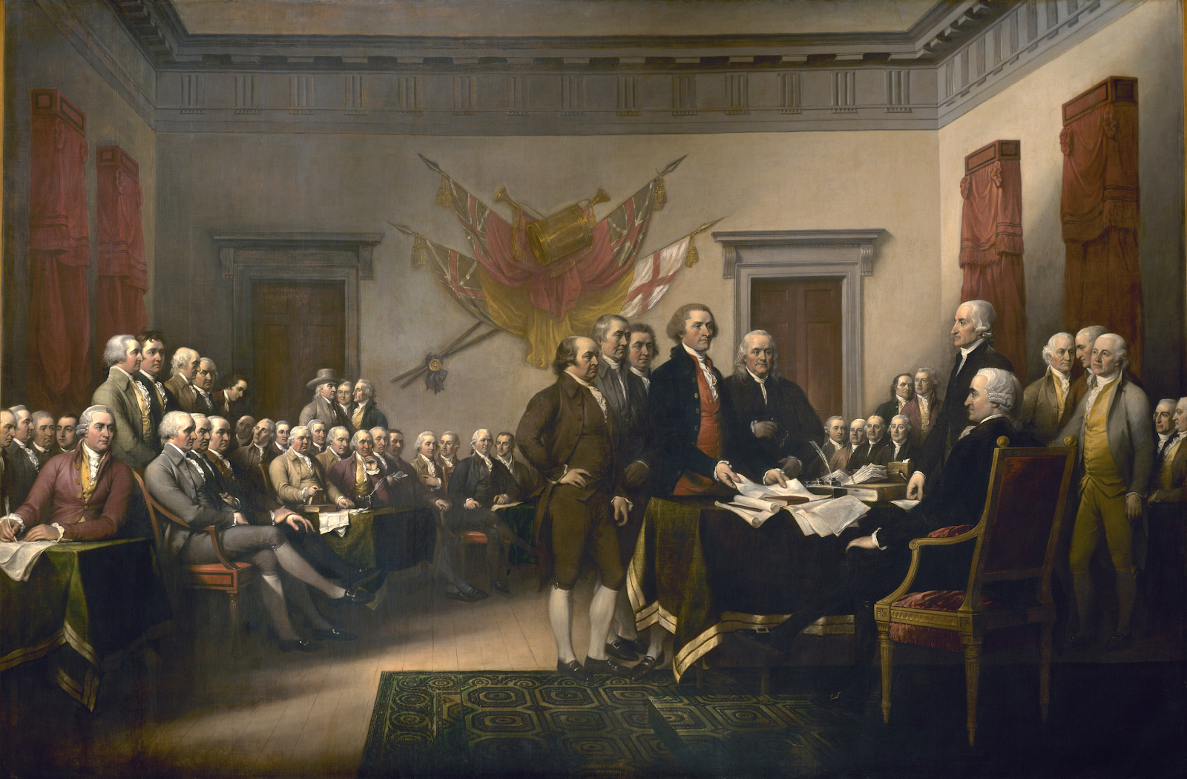
NEXT CLASS -- Early United States History

Slide 32
IF YOU HAVE ANY QUESTIONS
Call the Columbus Junction public library: 319-728-7972
Email Mandy Grimm at: mandy.grimm@columbusjct.lib.ia.us

