Slide 1
Citizenship Class
Session 3: The Legislative Branch and the Judicial Branch

Slide 2
Three Branches of Government

Slide 3
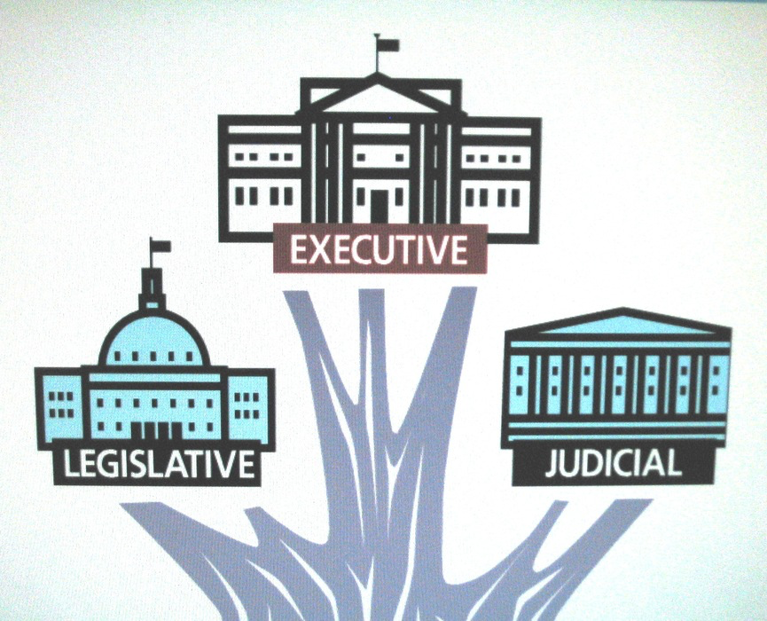
Three Branches of Government
The Constitution divides the government into three branches:
Executive
Legislative
Judicial
Each of the three branches has specific powers. This creates a system called checks and balances, or the separation of powers.
The point of checks and balances/separation of powers is to stop one branch from becoming too powerful.

Slide 4
Three Branches of Government
The Constitution divides the government into three branches:
Executive
Legislative
Judicial
Each of the three branches has specific powers. This creates a system called checks and balances, or the separation of powers.
The point of checks and balances/separation of powers is to stop one branch from becoming too powerful.
Question #1 and #2

Slide 5
The Legislative Branch

Slide 6
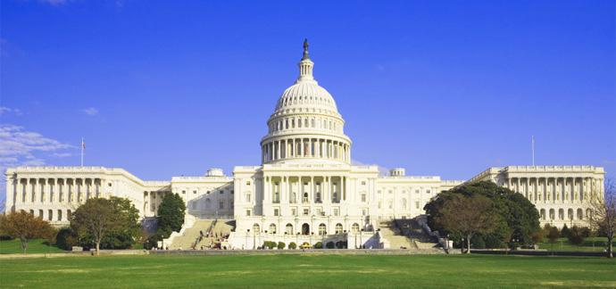
The Legislative Branch
The Legislative Branch is also known as the Legislature or Congress. This branch of the government makes federal laws.
The Legislative Branch is made up of two parts: the House of Representatives and the Senate. They meet at the Capitol Building in Washington D.C.
The Legislative Branch = Legislature = Congress = House & Senate

Slide 7
The Legislative Branch
The Legislative Branch is also known as the Legislature or Congress. This branch of the government makes federal laws.
The Legislative Branch is made up of two parts: the House of Representatives and the Senate. They meet at the Capitol Building in Washington D.C.
The Legislative Branch = Legislature = Congress = House & Senate
Question #3 and #4

Slide 8
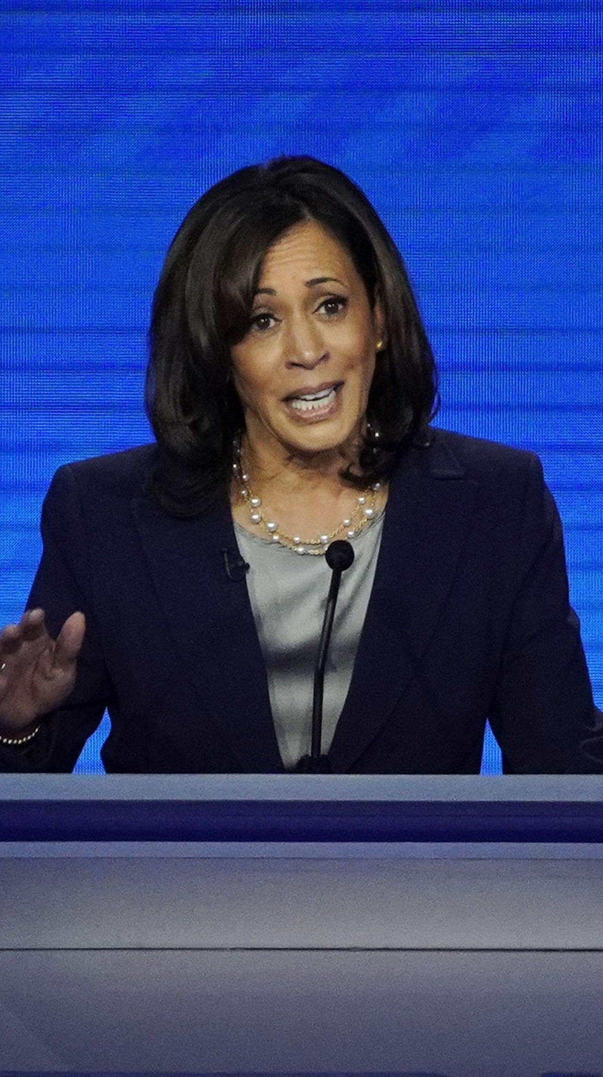
The Senate
A senator represents all the people of their state. Each state elects 2 senators, for a total of 100 senators.
To become a senator, you must be at least 30 years old and a United States citizen for at least 9 years. Senators are elected to 6 year terms, and can be re-elected without limit.
The leader of the Senate, and the tie-breaker if necessary, is the Vice President of the United States. The Vice President is Kamala Harris.

Slide 9
The Senate
A senator represents all the people of their state. Each state elects 2 senators, for a total of 100 senators.
To become a senator, you must be at least 30 years old and a United States citizen for at least 9 years. Senators are elected to 6 year terms, and can be re-elected without limit.
The leader of the Senate, and the tie-breaker if necessary, is the Vice President of the United States. The Vice President is Kamala Harris.
Question #5, #6, and #7

Slide 10
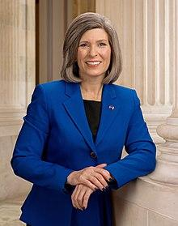
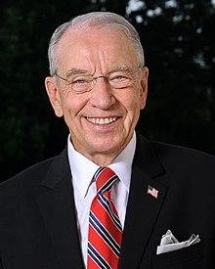
The Senate - Iowa
Chuck Grassley has been an Iowa senator since 1981. He is the longest serving Republican member of the Senate.
Joni Ernst has been an Iowa senator since 2015. She won her re-election campaign in 2020, and will return for another 6 years.

Slide 11
The Senate - Iowa
Chuck Grassley has been an Iowa senator since 1981. He is the longest serving Republican member of the Senate.
Joni Ernst has been an Iowa senator since 2015. She won her re-election campaign in 2020, and will return for another 6 years.
Question #8

Slide 12
The House of Representatives
There are 435 voting members of the House of Representatives.
The number of representatives a state has depends on the state’s population; states with more people have more representatives.
Representatives must be at least 25 years old and a United States citizen for at least 7 years. They are elected to 2 years terms, and can be re-elected without limit.

Slide 13
The House of Representatives
There are 435 voting members of the House of Representatives.
The number of representatives a state has depends on the state’s population; states with more people have more representatives.
Representatives must be at least 25 years old and a United States citizen for at least 7 years. They are elected to 2 years terms, and can be re-elected without limit.
Question #9, #10, and #11

Slide 14
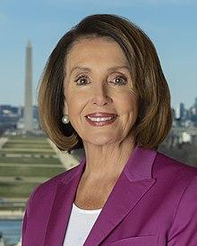
Speaker of the House
The leader of the House of Representatives is chosen by the party with the majority of members. This leader is given the special title of ‘Speaker of the House’. Democrats currently hold the majority. The current Speaker of the House is Nancy Pelosi.

Slide 15
Speaker of the House
The leader of the House of Representatives is chosen by the party with the majority of members. This leader is given the special title of ‘Speaker of the House’. Democrats currently hold the majority. The current Speaker of the House is Nancy Pelosi.
Question #12

Slide 16
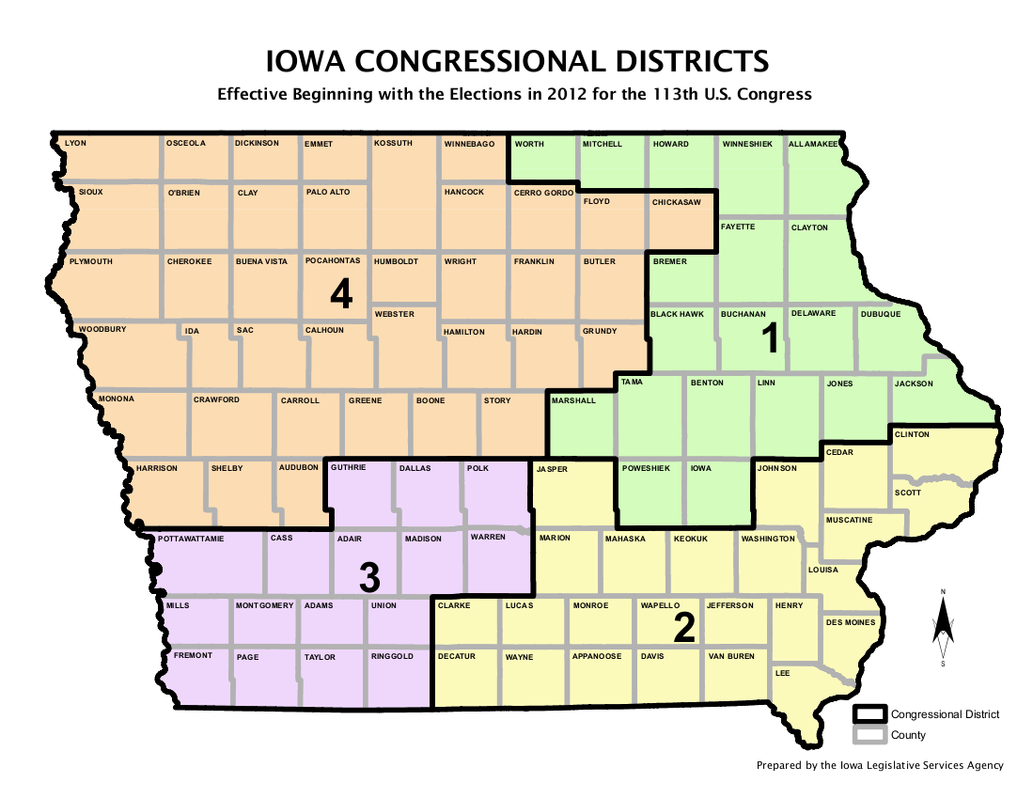
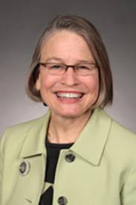
The House of Representatives - Iowa
Iowa has 4 congressional districts, meaning we have 4 representatives.
These representatives are:
Ashley Hinson
Mariannette Miller-Meeks
Cindy Axne
Randy Feenstra
Mariannette Miller-Meeks represents District 2.

Slide 17
The House of Representatives - Iowa
Iowa has 4 congressional districts, meaning we have 4 representatives.
These representatives are:
Ashley Hinson
Mariannette Miller-Meeks
Cindy Axne
Randy Feenstra
Mariannette Miller-Meeks represents District 2.
Question #13

Slide 18
The Judicial Branch

Slide 19
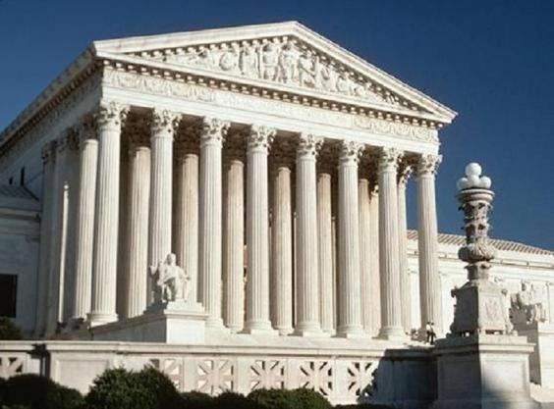
The Judicial Branch
The Judicial Branch of the United States government includes the Supreme Court and the federal courts. These courts review laws, explain laws, and resolve disputes.
The highest court in the United States is the Supreme Court. It is the final judge of cases involving the Constitution.

Slide 20
The Judicial Branch
The Judicial Branch of the United States government includes the Supreme Court and the federal courts. These courts review laws, explain laws, and resolve disputes.
The highest court in the United States is the Supreme Court. It is the final judge of cases involving the Constitution.
Question #14 and #15

Slide 21
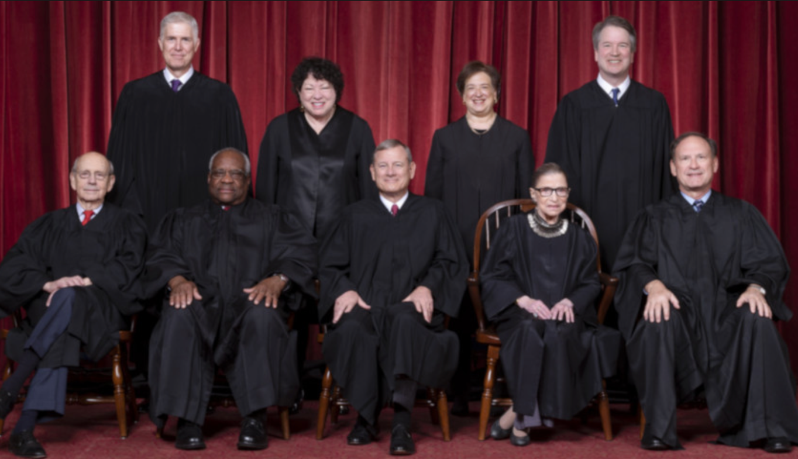
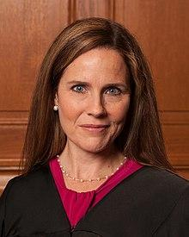
The Supreme Court
The Supreme Court is made up of 9 judges, called justices. One serves as the leader, known as the Chief Justice.
These justices are appointed by the president, and approved by the Senate.
The Supreme Court decides cases based on the Constitution, and their decision is final.
John Roberts Jr. is the Chief Justice.

Slide 22
The Supreme Court
The Supreme Court is made up of 9 judges, called justices. One serves as the leader, known as the Chief Justice.
These justices are appointed by the president, and approved by the Senate.
The Supreme Court decides cases based on the Constitution, and their decision is final.
John Roberts Jr. is the Chief Justice.
Question #16 and #17

Slide 23
WORKSHEET REVIEW
1. Executive/Legislative/Judicial
2. Checks and balances/separation of powers
3. Legislative Branch/Legislature/Congress
4. House of Representatives and Senate
5. All the people of their state
6. 100
7. 6 years
8. Chuck Grassley/Joni Ernst
9. 435
10. Population
11. 2 years
12. Nancy Pelosi
13. Mariannette Miller-Meeks
14. Review laws/explain laws/resolve disputes
15. The Supreme Court
16. Nine/9
17. John Roberts/John Roberts Jr.

Slide 24
Dictation Practice
There are three branches of the federal government.
We have 100 senators.
The Supreme Court is the highest court in the United States.

Slide 25
WHAT TO DO BEFORE NEXT SESSION
Writing Practice
Write out the five sentences
Practice saying them outloud
Reading exercise
Practice Reading “U.S. Government: The Legislature”
Read out loud!!

Slide 26
NEXT CLASS -- The Executive Branch

Slide 27
IF YOU HAVE ANY QUESTIONS
Call the Columbus Junction Public Library: 319-728-7972
Email Mandy Grimm at: mandy.grimm@columbusjct.lib.ia.us

