Slide 1
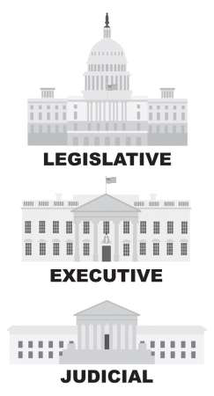
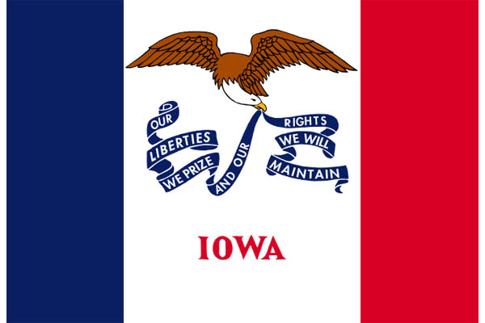
Citizenship Class
Session 4: The Executive Branch and Iowa Government

Slide 2
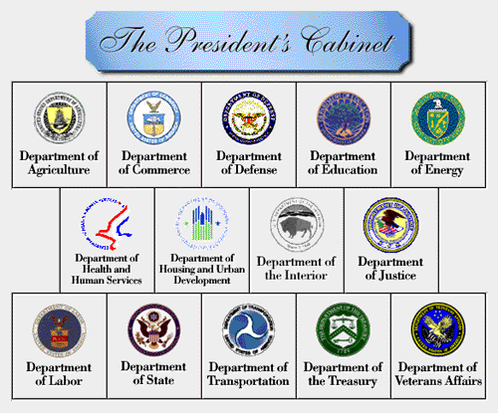
The Executive Branch
The Executive Branch enforces laws that are passed by Congress.
The President, Vice President, and the Cabinet
The Cabinet consists of the Vice President and leaders of federal departments.

Slide 3
The President

Slide 4
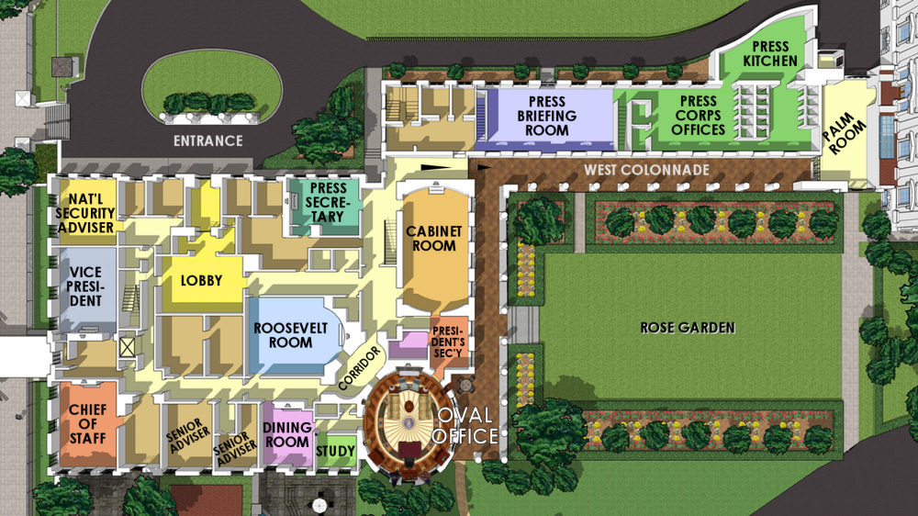

The President
The President is the leader of the country, and is in charge of the Executive Branch. The President is also the Commander-in-Chief of the military.
The President lives and works in the White House at 1600 Pennsylvania Avenue in Washington, D.C.

Slide 5
The President
The President is the leader of the country, and is in charge of the Executive Branch. The President is also the Commander-in-Chief of the military.
The President lives and works in the White House at 1600 Pennsylvania Avenue in Washington, D.C.
Question #1 and #2

Slide 6

Presidential Qualification and Election
To be president, a person must be a natural-born citizen of the United States, must be at least 35 years old, and must have lived in the United States for 14 years.
We vote for President in November. The president serves a term of four years, and is limited to two terms.

Slide 7
Presidential Qualification and Election
To be president, a person must be a natural-born citizen of the United States, must be at least 35 years old, and must have lived in the United States for 14 years.
We vote for President in November. The president serves a term of four years, and is limited to two terms.
Question #3

Slide 8
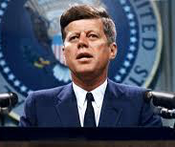
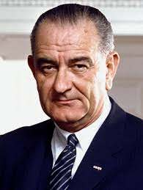
If the President Can No Longer Serve
If the event occurs where the President can no longer serve, the Vice President becomes the President.
If neither the President nor the Vice President can serve, the Speaker of the House becomes President.

Slide 9
If the President Can No Longer Serve
If the event occurs where the President can no longer serve, the Vice President becomes the President.
If neither the President nor the Vice President can serve, the Speaker of the House becomes President.
Question #4 and #5

Slide 10
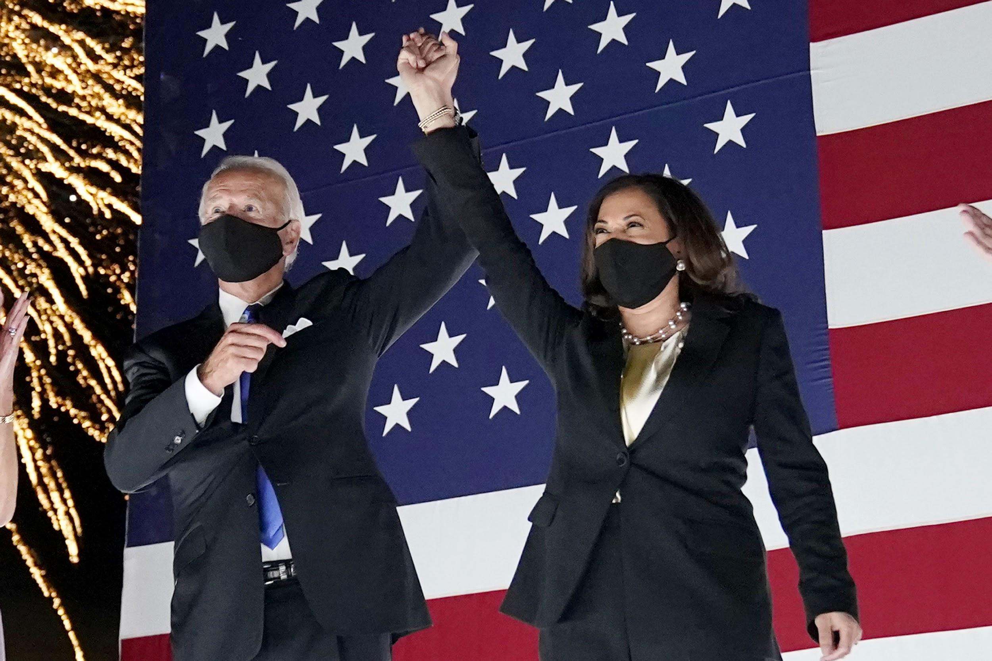
The President and the Vice President
Currently, the President is Joe Biden, and the Vice President is Kamala Harris. They are from the Democratic Party.

Slide 11
The President and the Vice President
Currently, the President is Joe Biden, and the Vice President is Kamala Harris. They are from the Democratic Party.
Question #6, #7, and #8

Slide 12
The Cabinet

Slide 13
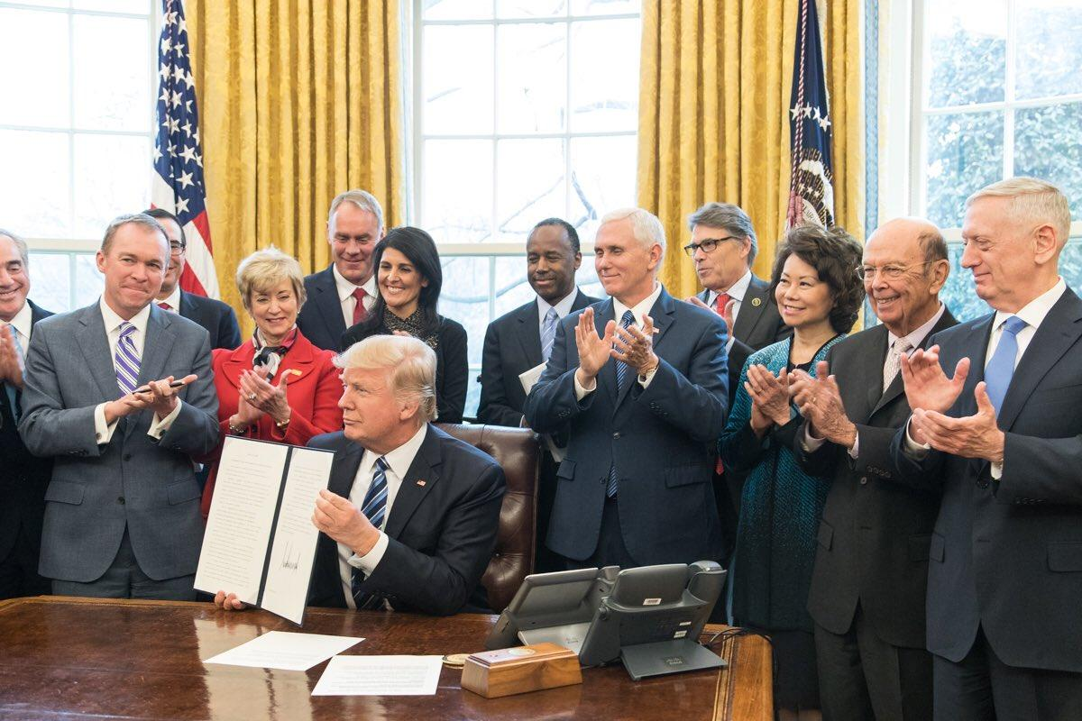
The Cabinet
The Cabinet advises the President. There are 15 cabinet members, plus the Vice President.
Some cabinet members are the Secretary of State, Secretary of Defense, Secretary of Education, and Secretary of Labor.

Slide 14
The Cabinet
The Cabinet advises the President. There are 15 cabinet members, plus the Vice President.
Some cabinet members are the Secretary of State, Secretary of Defense, Secretary of Education, and Secretary of Labor.
Question #9 and #10

Slide 15
Laws in the Executive Branch

Slide 16
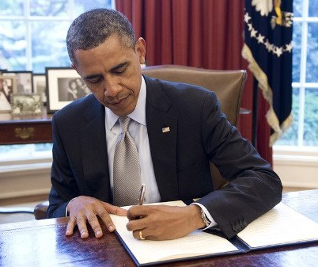
Making New Laws
The Legislative Branch (Congress) writes bills and approves them by vote. A bill is a new law.
A bill that is approved by Congress is sent to the President. If the President signs the bill, it becomes a law. If the President vetoes a bill, it does not become a law.

Slide 17
Making New Laws
The Legislative Branch (Congress) writes bills and approves them by vote. A bill is a new law.
A bill that is approved by Congress is sent to the President. If the President signs the bill, it becomes a law. If the President vetoes a bill, it does not become a law.
Question #11 and #12

Slide 18
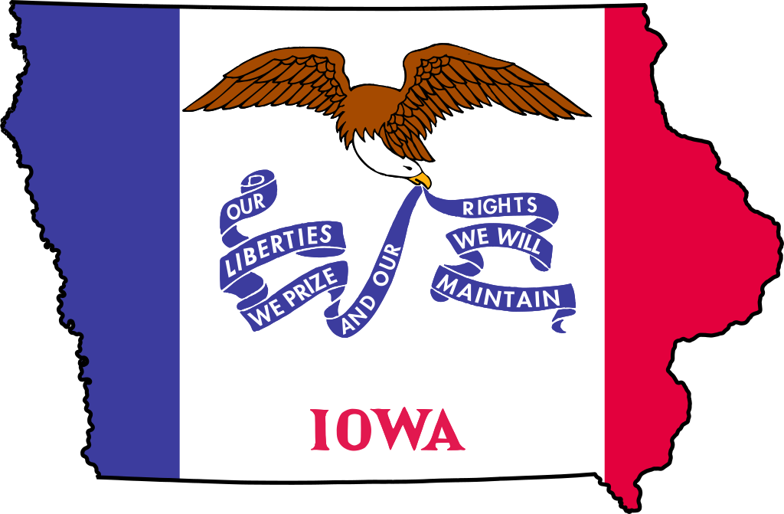
State Government - Introduction
Each state has its own government and constitution. Like the federal government, each state government has three branches: Legislative, Executive, and Judicial.
The state legislature makes state laws. These laws must agree with the United States Constitution.

Slide 19
Iowa Government

Slide 20
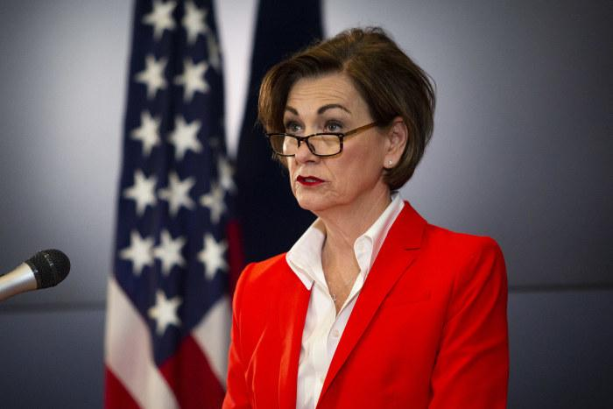
Iowa Government
The chief executive of Iowa is the governor, who enforces states laws and prepares the state budget.
Iowa’s governor is Kim Reynolds, of the Republican Party.
The governor of Iowa works in the state capital city of Des Moines.

Slide 21
Iowa Government
The chief executive of Iowa is the governor, who enforces states laws and prepares the state budget.
Iowa’s governor is Kim Reynolds, of the Republican Party.
The governor of Iowa works in the state capital city of Des Moines.
Question #13 and #14

Slide 22
WORKSHEET REVIEW
1. The President
2. The President
3. Four years
4. Vice President
5. Speaker of the House
6. Joe Biden
7. Kamala Harris
8. Democratic Party
9. Advises the President
10. Secretary of State/Defense/Education/Labor
11. The President
12. The President
13. Kim Reynolds
14. Des Moines

Slide 23
Dictation Practice
The President lives in the White House.
There are 15 cabinet members that advise the President.
The Governor of Iowa works in Des Moines.

Slide 24
WHAT TO DO BEFORE NEXT SESSION
Writing Practice
  Write out the eight sentences
  Practice saying them out loud
Reading Exercises
  Practice reading “Executive Branch” AND “Iowa”
    Read out loud!!

Slide 25
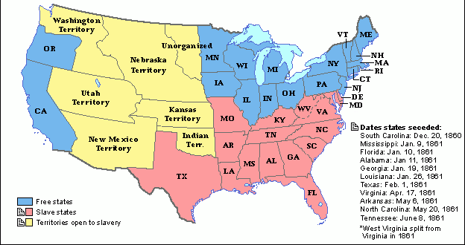
NEXT CLASS -- Expansion and Civil War

Slide 26
IF YOU HAVE ANY QUESTIONS
Call the Columbus Junction Public Library: 319-728-7972
Email Mandy Grimm at: mandy.grimm@columbusjct.lib.ia.us

