Slide 1
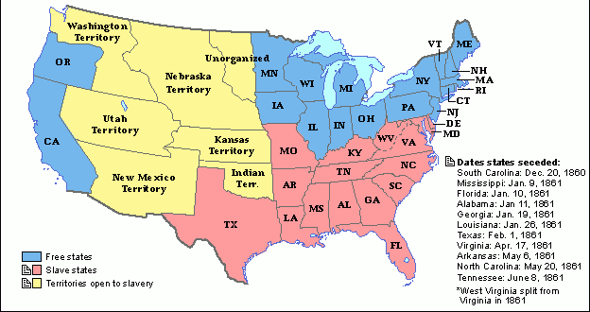
Citizenship Class
Session 5: Expansion and the Civil War

Slide 2
Expansion

Slide 3
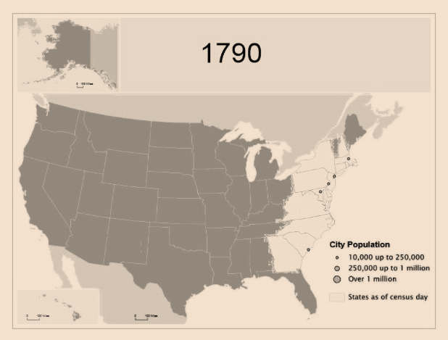
United States Expansion - Introduction
In 1790, after gaining independence from Great Britain, there were 14 states in the United States. The population of the United States was 3,231,533.
The current estimated population of the United States in 2020 is 331,002,651.

Slide 4
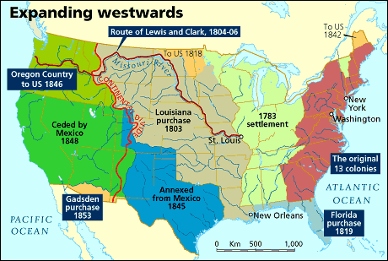
United States Expansion
In 1803, the United States purchased the Louisiana Territory from France for $15 million.
This allowed the country to begin its expansion to the west.

Slide 5
United States Expansion
In 1803, the United States purchased the Louisiana Territory from France for $15 million.
This allowed the country to begin its expansion to the west.
Question #1

Slide 6
Wars of the 1800s

Slide 7
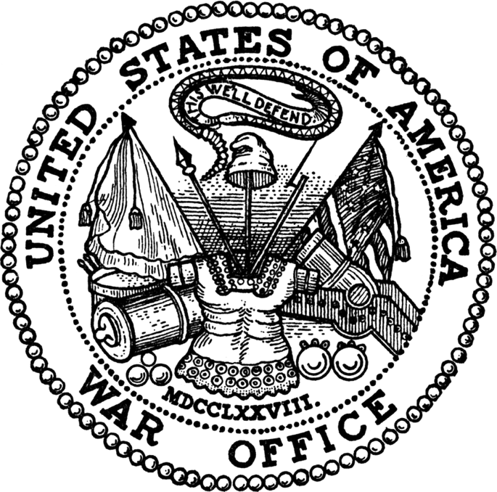
Wars of the 1800s - Part 1
War of 1812 - U.S. versus Great Britain (1812-1815)
British attempts to restrict U.S. trade
America’s desire to expand
Mexican American War - U.S versus Mexico (1846-1848)
Fight over where the border between countries would be
Mexico lost one third of its territory to the U.S.
  California, Nevada, Arizona, and New Mexico

Slide 8
Wars of the 1800s - Part 2
Civil War - U.S. versus U.S. (1861-1865)
North and South
Slavery, economics, and state’s rights
Spanish American War - U.S. versus Spain (1898)
Conflict ended with U.S. controlling Puerto Rico and Guam (U.S. territories)
Cuba became independent from Spain

Slide 9
Wars of the 1800s
War of 1812
Mexican American War
Civil War
Spanish American War
Question #2

Slide 10
Slavery

Slide 11
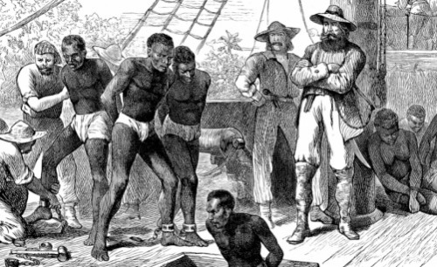
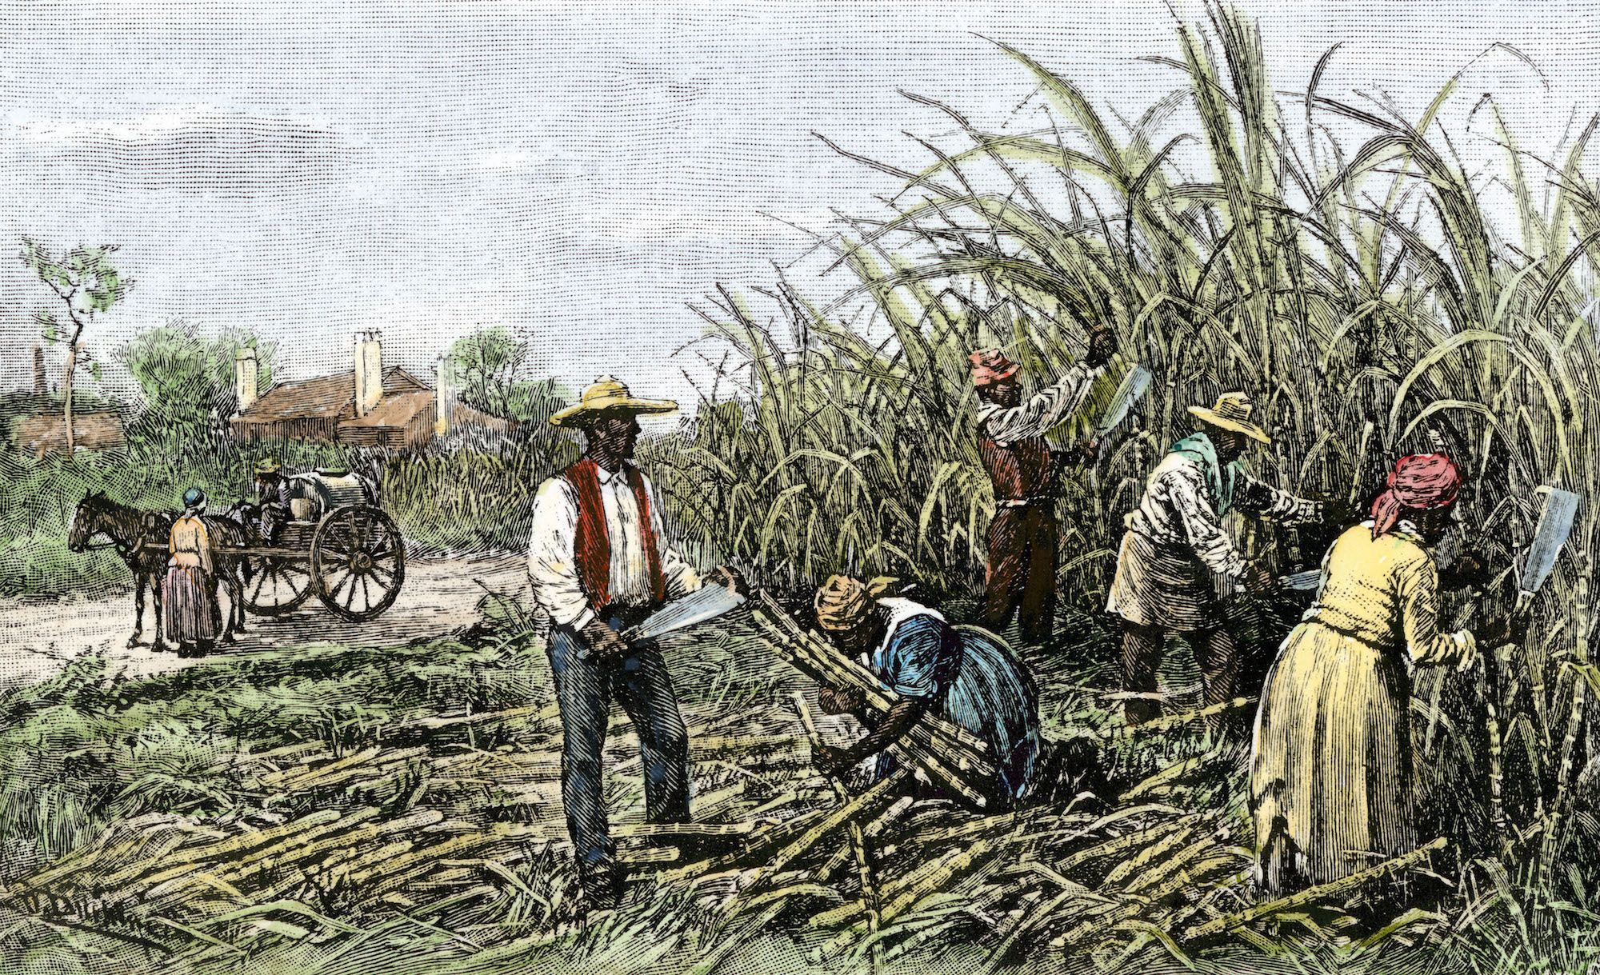
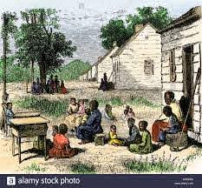
Slavery in the United States
From the 1600s to the 1800s, Africans were forced to come to the United States. They were taken to be slaves.
After being sold to wealthy owners, many slaves worked on southern plantations. A plantation is a large farm.

Slide 12
Slavery in the United States
From the 1600s to the 1800s, Africans were forced to come to the United States. They were taken to be slaves.
After being sold to wealthy owners, many slaves worked on southern plantations. A plantation is a large farm.
Question #3

Slide 13
The Civil War (1861-1865)

Slide 14
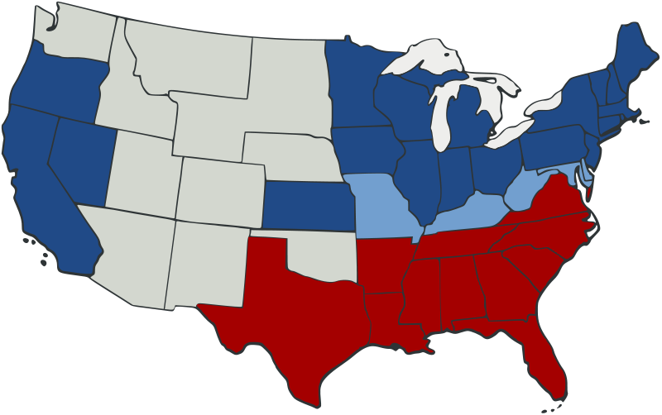
Problems that led to the Civil War
Separate cultures developed in the North and South.
Most southerners believed in slavery. Their economy was built around cotton plantations, and nearly one-third of white southerners owned slaves. Southern states believed in a small federal government and state’s rights.
The economy of northern states relied more on factories and growing cities. The North was also against the spread of slavery to the new western states.

Slide 15
Problems that led to the Civil War
Separate cultures developed in the North and South.
Most southerners believed in slavery. Their economy was built around cotton plantations, and nearly one-third of white southerners owned slaves. Southern states believed in a small federal government and state’s rights.
The economy of northern states relied more on factories and growing cities. The North was also against the spread of slavery to the new western states.
Question #4

Slide 16

The Union and The Confederacy
In 1861, the same year Abraham Lincoln was elected President, several southern states seceded (separated) from the Union and formed the Confederate States of America. This was the beginning of the Civil War, between the North and the South.
In 1863, President Lincoln, not wanting the nation to be divided by slavery, signed the Emancipation Proclamation. The Emancipation Proclamation freed the slaves.

Slide 17
The Union and The Confederacy
In 1861, the same year Abraham Lincoln was elected President, several southern states seceded (separated) from the Union and formed the Confederate States of America. This was the beginning of the Civil War, between the North and the South.
In 1863, President Lincoln, not wanting the nation to be divided by slavery, signed the Emancipation Proclamation. The Emancipation Proclamation freed the slaves.
Question #5 and #6

Slide 18
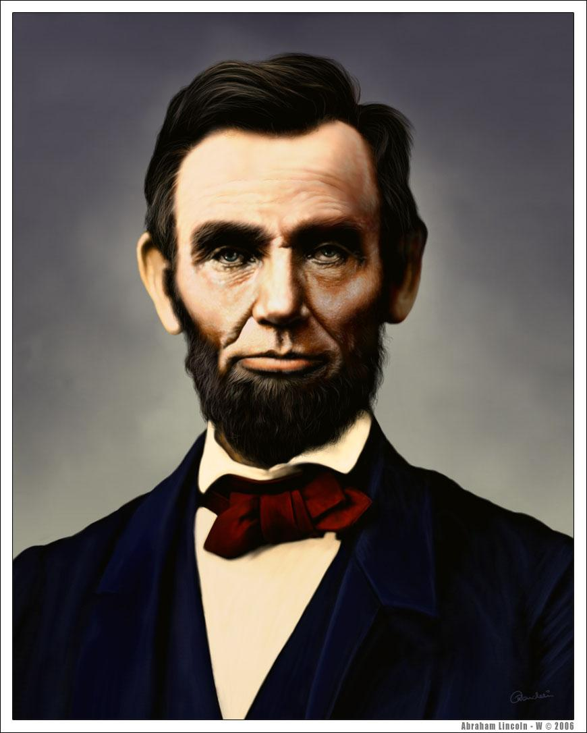
Abraham Lincoln
Between 1861 and 1865, the Civil War claimed over 600,000 lives. On April 9, 1865, the Confederate Army surrendered in Virginia.
Five days later, President Lincoln was shot and killed.
Americans remember Lincoln because he united the country, freed the slaves, and led the country during the Civil War. His birthday and Washington’s are honored on Presidents’ Day in February.

Slide 19
Abraham Lincoln
Between 1861 and 1865, the Civil War claimed over 600,000 lives. On April 9, 1865, the Confederate Army surrendered in Virginia.
Five days later, President Lincoln was shot and killed.
Americans remember Lincoln because he united the country, freed the slaves, and led the country during the Civil War. His birthday and Washington’s are honored on Presidents’ Day in February.
Question #7

Slide 20
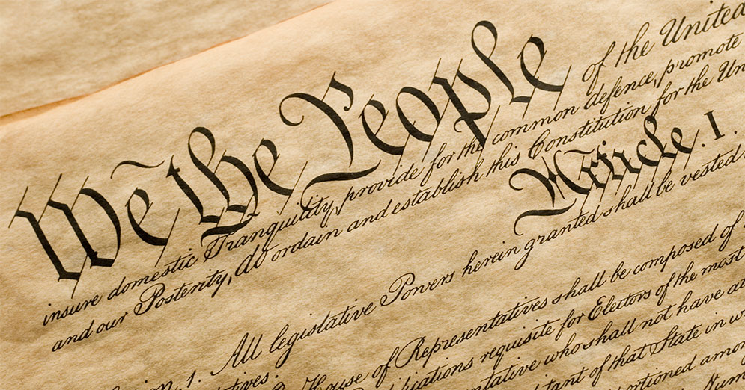
Amendments to the Constitution Related to the Civil War
The 13th Amendment - adopted December 6, 1865
Abolished slavery in the United States
The 14th Amendment - adopted July 9, 1868
Addresses citizenship rights and equal protection of laws for all people, including non-citizens
The 15th Amendment - adopted February 3, 1870
Gave former slaves and all men, regardless of race, the right to vote

Slide 21
WORKSHEET REVIEW
Louisiana Territory
War of 1812/Mexican American War/Civil War/Spanish American War
Africans
Slavery/state’s rights/economy
The Civil War
Freed the slaves
United the country/freed the slaves/led the country during the Civil War

Slide 22
Dictation Practice
Lincoln was the president during the Civil War.
The Civil War was fought between the North and the South.
The Louisiana Territory was purchased in 1803.

Slide 23
WHAT TO DO BEFORE NEXT SESSION
Writing Practice
  Write out the eight sentences
  Practice saying them out loud
Reading Practice
  Practice reading ‘The Civil War’
    Read out loud!!

Slide 24
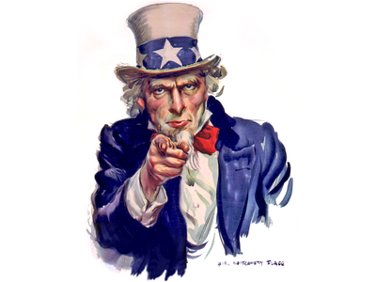
NEXT CLASS -- 1900s History and World Wars

Slide 25
IF YOU HAVE ANY QUESTIONS
Call the Columbus Junction Public Library: 319-728-7972
Email Mandy Grimm at: mandy.grimm@columbusjct.lib.ia.us

