Slide 1
Citizenship Class
Session 3 and 4 Review
**Watch this video before going on to Session 5

Slide 2
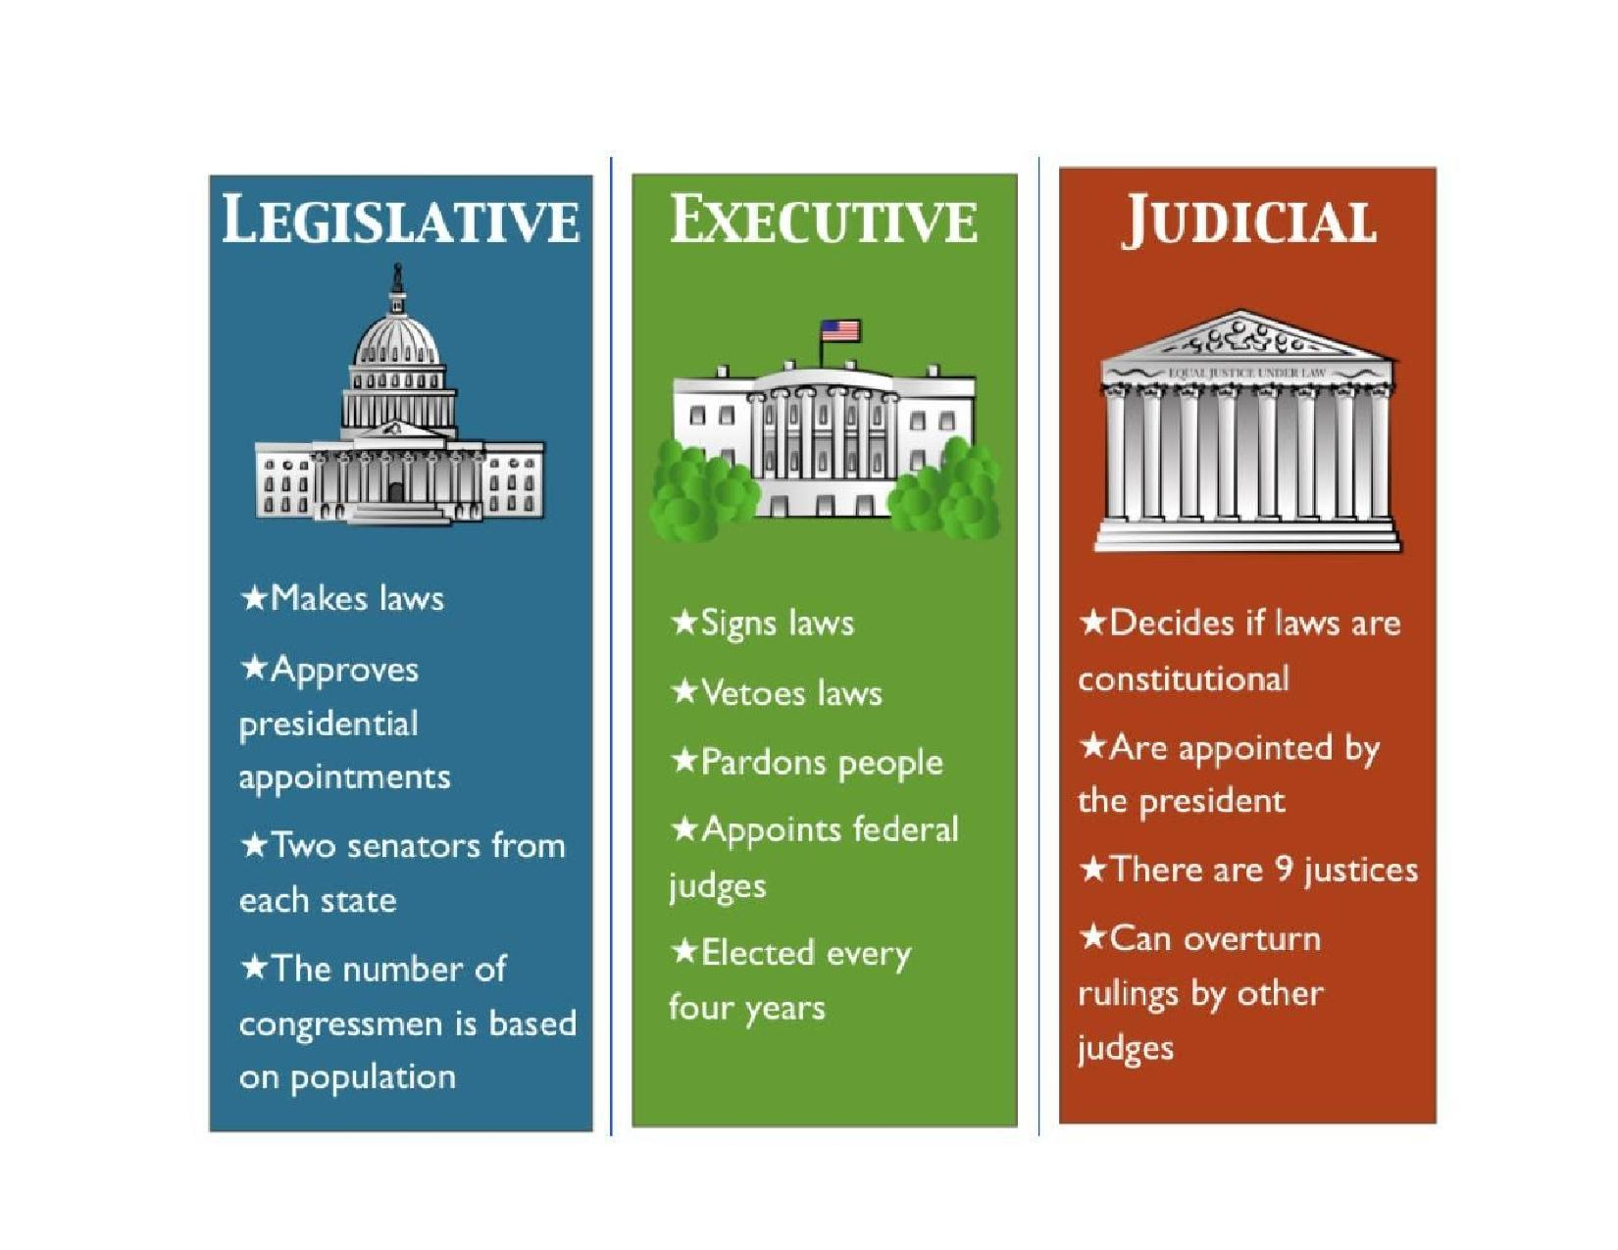

Slide 3
Review Session 3 and 4 Homework

Slide 4
Writing Sentences
1. Our government is divided into three branches.
2. The House and Senate are parts of Congress.
3. The President is elected every four years.
4. The President lives in the White House.
5. The Governor of Iowa is Kim Reynolds.

Slide 5
What we Learned in Session 3

Slide 6
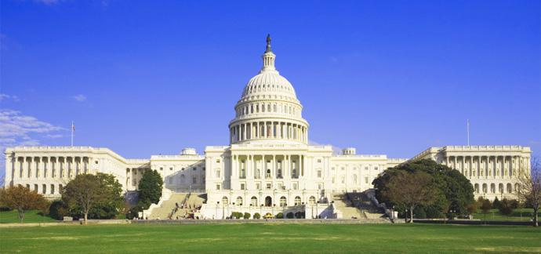
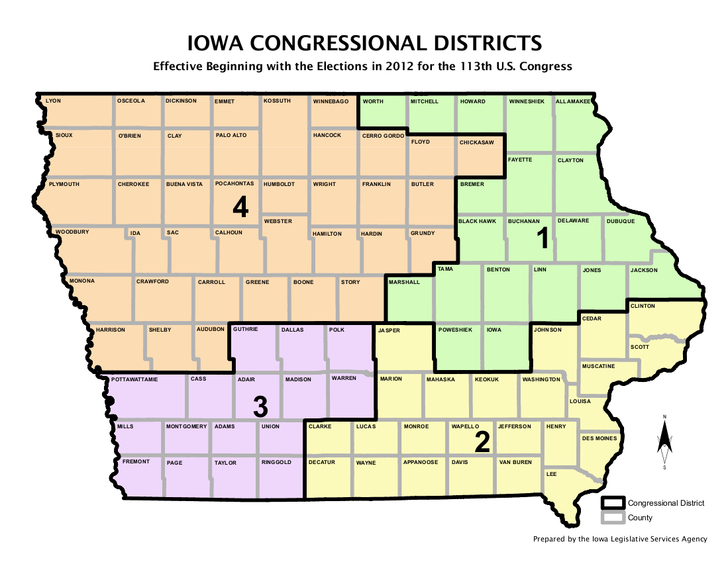
The Legislative Branch
**Section ‘A’ on your fill in the blanks worksheet

Slide 7
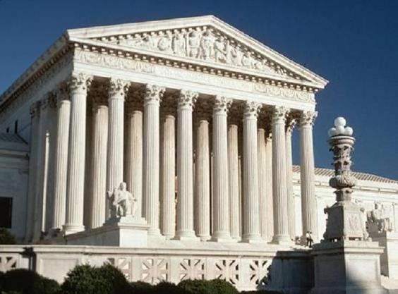
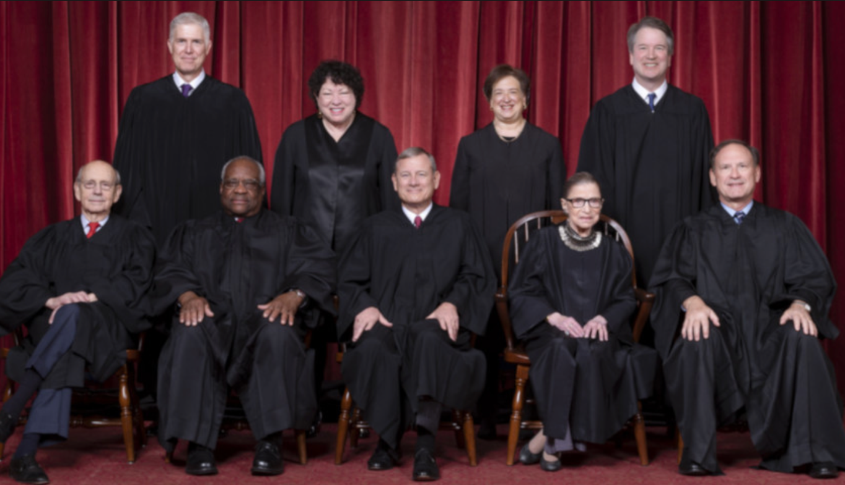
The Judicial Branch
**Section ‘B’ on your fill in the blanks worksheet

Slide 8
What we Learned in Session 4

Slide 9
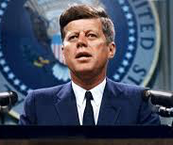
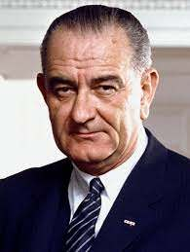
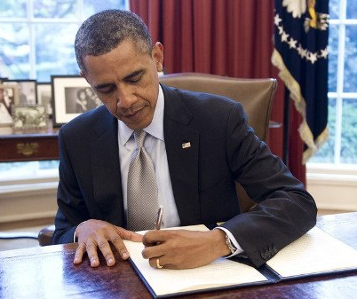
The Executive Branch
**Section ‘C’ on your fill in the blanks worksheet

Slide 10
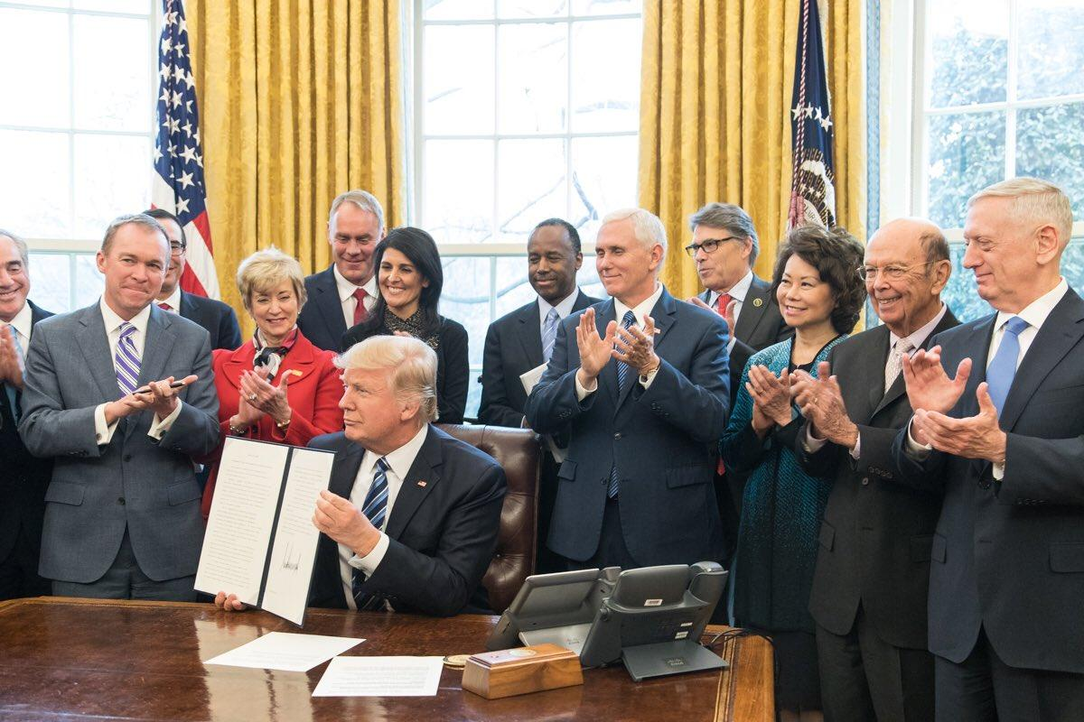
The Cabinet
**Section ‘D’ on your fill in the blanks worksheet

Slide 11
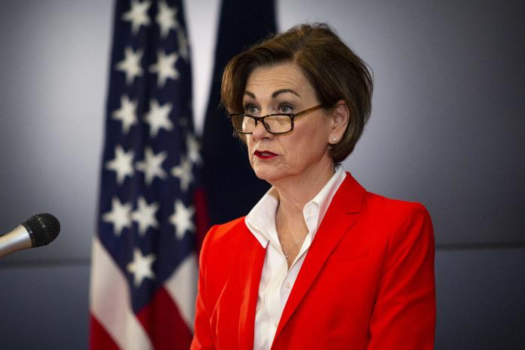
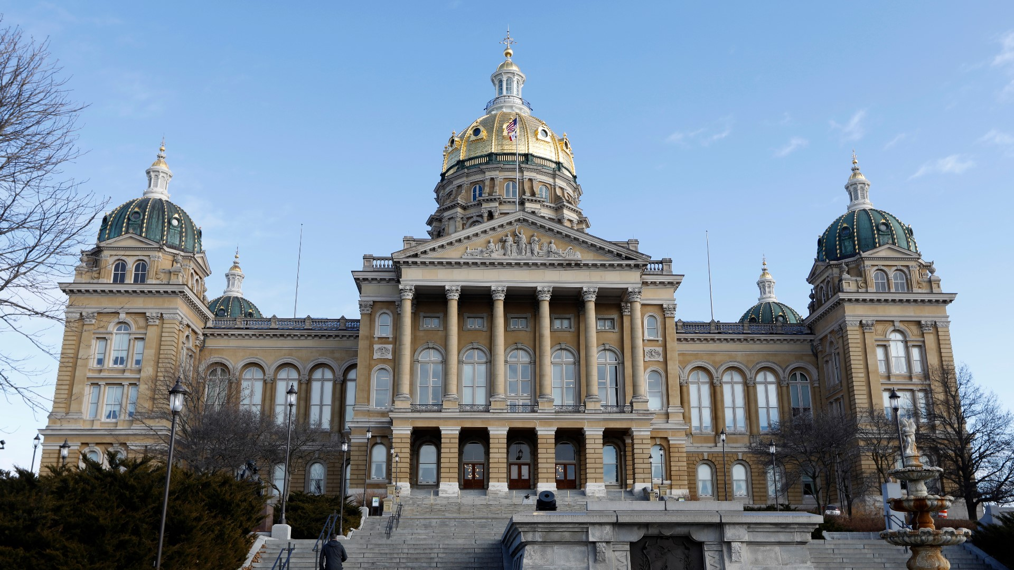
State Government
**Section ‘E’ on your fill in the blanks worksheet

Slide 12
Fill in the Blank Questions
Section A:
The Legislative Branch is made up of two parts, the ______________________ and the _________________________________.
Each state elects ______________________ senators.
The leader of the Senate is the _________________________________. Their job is to break ties.
Representatives are divided based on population. Iowa has _____________________ representatives.

Slide 13
Fill in the Blank Questions
Section B:
The Judicial Branch is composed of the Supreme Court and other ____________________________.
The Supreme Court is the final judge of cases involving the ____________________________.
The nine justices of the Supreme Court must be appointed by the _________________________ and approved by the _________________________.

Slide 14
Fill in the Blank Questions
Section C:
The ___________________ is in charge of the Executive Branch, and is also the Commander in Chief of the ______________________.
The President is elected for __________________ years. Election Day is always in _____________________.
If the President can no longer serve, the next in line is the __________________ and then the ________________________________.
The President can either ________________ or _______________ bills.

Slide 15
Fill in the Blank Questions
Section D:
The role of the cabinet is to ___________________ the President.
Two cabinet positions are ______________________________________ and ___________________________________________________________.

Slide 16
Fill in the Blank Questions
Section E:
____________________________________ is the governor of Iowa.
The capital of Iowa is _________________________________________.

Slide 17
Answers to Session 3 and 4 Review
Section C:
1. President; military
2. 4; November
3. Vice President; Speaker of the House
4. Sign; veto
Section D:
1. Advise
2. Secretary of State; Secretary of Defense
Section E:
1. Kim Reynolds
2. Des Moines
Section A:
1. Senate; House of Representatives
2. 2
3. Vice President
4. 4
Section B:
1. Federal courts
2. Constitution
3. President; Senate

Slide 18
End of Review!
**Once you feel confident with Sessions 3 and 4, and have completed this video, move onto Session 5!

