Slide 1
Citizenship Class
Session 5 and 6 Review
**Watch this video before going on to Session 7

Slide 2
Review Session 5 and 6 Homework

Slide 3
Reading Sentences
1. Abraham Lincoln was president during the Civil War.
2. Only Congress can declare war.
3. It is important for all citizens to vote.
4. Any citizen can vote once they are 18 years old.
5. Franklin Roosevelt (FDR) was President during the Great Depression.

Slide 4
What we Learned in Session 5

Slide 5
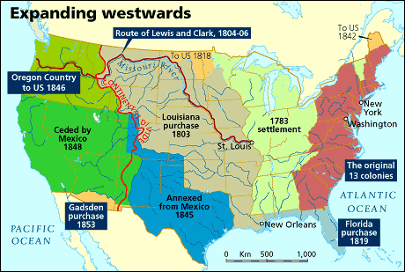
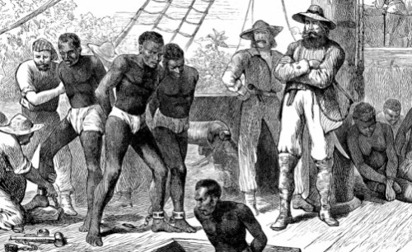

Expansion and the Civil War
**Section ‘A’ on your fill in the blanks worksheet

Slide 6
What we Learned in Session 6

Slide 7
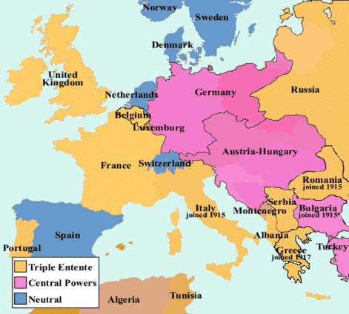
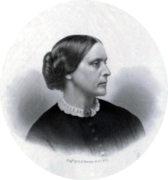
1900s History
**Section ‘B’ on your fill in the blanks worksheet

Slide 8
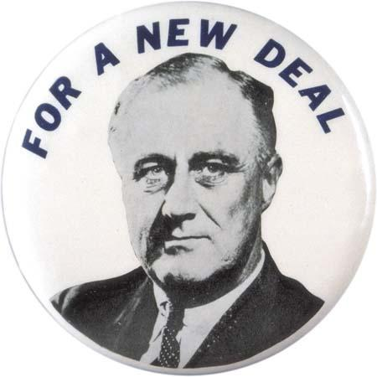
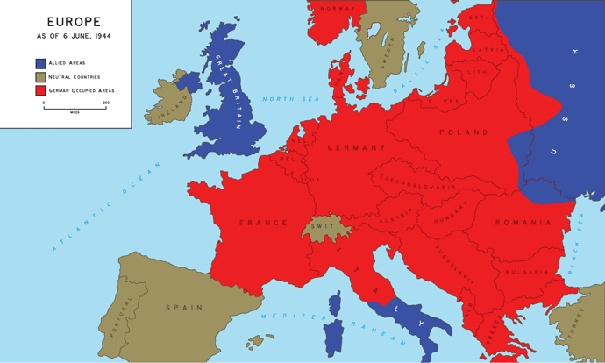
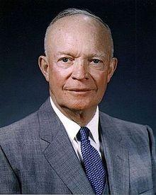
1900s History
**Section ‘B’ on your fill in the blanks worksheet

Slide 9
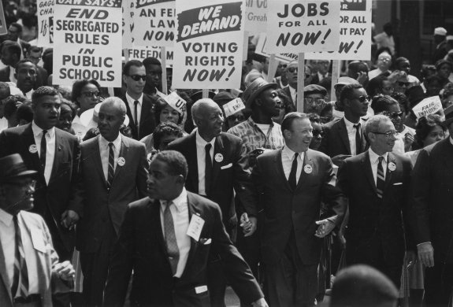
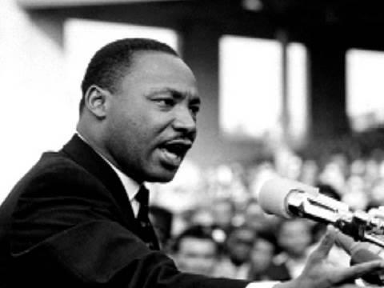
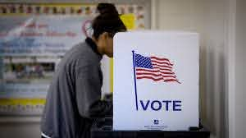
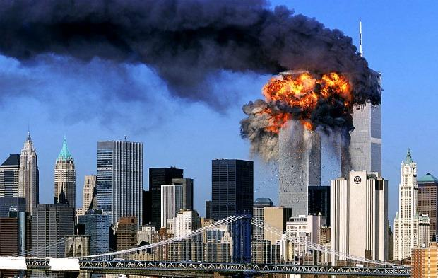
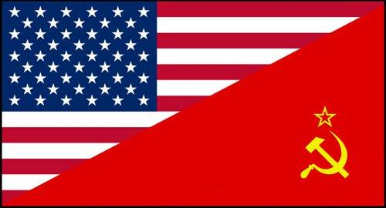
1900s History
**Section ‘B’ on your fill in the blanks worksheet

Slide 10
Fill in the Blank Questions
Section A:
1. The United States purchased the ________________________ from France for $15 million in 1803.
2. In the time leading up to the Civil War, ____________________ were forced to come to the United States to be slaves.
3. The war between the North and South was the _____________. A variety of problems led to the war, including __________________.
4. President Lincoln signed the Emancipation Proclamation in 1863. The Emancipation Proclamation _________________________.

Slide 11
Fill in the Blank Questions
Section B:
1. During World War I, the United States was led by President _________________________________.
2. Susan B. Anthony fought for __________________________.
3. During the Great Depression and World War II, the United States was led by President ____________________________, also known as _______________.
4. The United States fought against the Axis Powers in World War II. The three countries that formed the Axis Powers were __________ _____________________________.

Slide 12
Fill in the Blank Questions
Section B:
5. President Eisenhower was a former war general who fought in _________________________.
6. The movement to end racial discrimination was the __________ ________________________. One of this movement’s leaders was ________________________________.
7. The are four amendments to the Constitution about voting. One of them is the 19th Amendment, which gives ___________________ _____________________________.

Slide 13
Fill in the Blank Questions
Section B:
8. The main concern of the United States during the Cold War was the spread of _____________________________.
9. The __________________________________ on the United States occurred on September 11, 2001.

Slide 14
Answers to Session 5 and 6 Review
Section B:
1. Woodrow Wilson
2. Women’s rights
3. Franklin Roosevelt; FDR
4. Germany, Japan, and Italy
5. World War II
6. Civil Rights Movement; Martin Luther King, Jr.
7. Women the right to vote
8. Communism
9. Terrorist attack
Section A:
1. Louisiana Territory
2. Africans
3. Civil War; slavery
4. Freed the slaves

Slide 15
End of Review!
**Once you feel confident with Sessions 5 and 6, and have completed this video, move onto Session 7!

